Slide 1
Department of Exceptionality Programs
At Bloomsburg University

Slide 2
3 Programs: Special Education Education of the Deaf ASL/English Interpreting
Department of Exceptionality Programs

Slide 3
Master of Science: Education of the Deaf
Department of Exceptionality Programs

Slide 4
Undergraduate Area of Concentration Education of the Deaf/HH

Slide 5
Freshman Year (suggested)
74.201 History, Education & Guidance of the Deaf/Hard of Hearing
Online or on campus course
Fall and Spring
75.155 American Sign Language I
Fall and Spring

Slide 6
Sophomore Year (suggested)
75.226 American Sign Language II
Fall and Spring
72.200 Introduction to Audiology
Spring preferred
74.305 Introduction to Instructional Methods for the Deaf/Hard of Hearing
Spring, Online and on campus

Slide 7
Junior Year (suggested)
Choice of one of the following courses:
74.462/562 ASL/Signed English in Educational Settings (preferred)
Fall
74.325 Practicum at Camp HERO-summer
74.461/561 Deaf/HH Technology-Based Observations/Interactions Across the Country
Independent study

Slide 8
Graduate Courses Education of the Deaf/HH

Slide 9
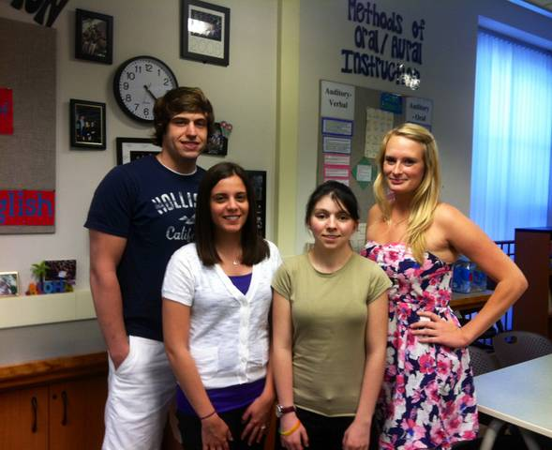
Deaf Education Graduate Students 2013

Slide 10
Deaf Education Graduate Students 2012 & 2011

Slide 11
Deaf Education Graduate Students 2010

Slide 12
Deaf Ed Grad Students‘09

Slide 13
First Summer Semester (12 weeks)
74.560 Practicum with the Deaf/Hard of Hearing
74.564 Speech with the Deaf/HH
74.566 Language for the Deaf/Hard of Hearing I
74.567 Language for the Deaf/Hard of Hearing II

Slide 14
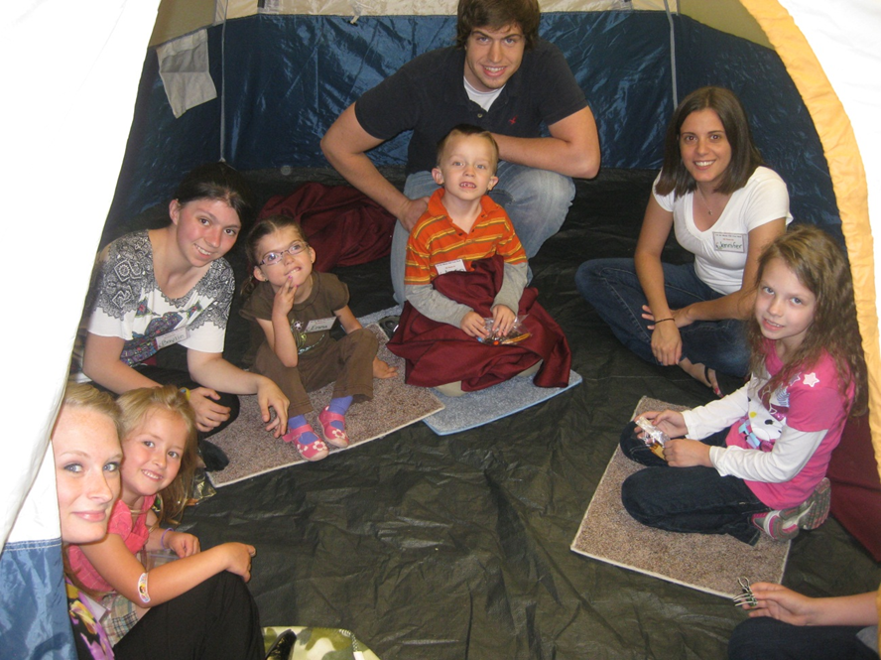
Mini-Camp 2012 Let the Music Fill Your Soul

Slide 15
Mini-Camp 2011 CELEBRATIONS

Slide 16
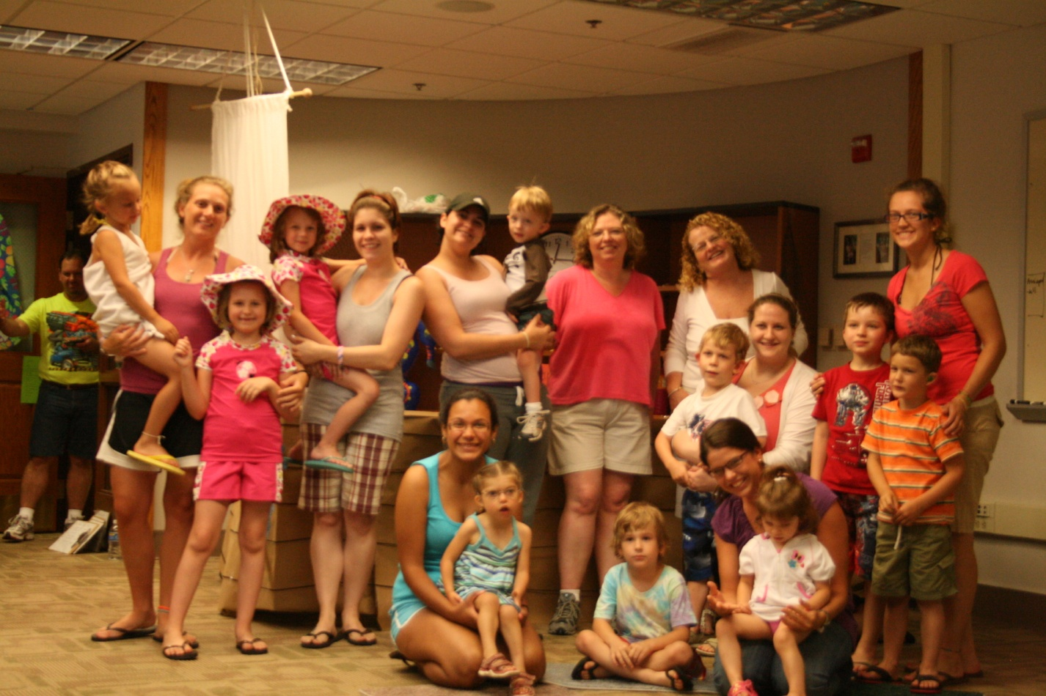
Mini-Camp 2010 PIRATES

Slide 17
Mini-Camp 2009 UNDER THE WATER

Slide 18
Group Activities 2012

Slide 19
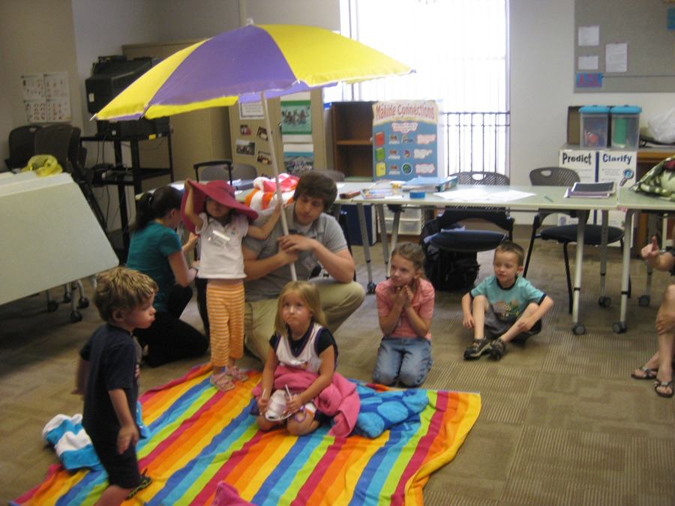
Summer Mini Camp Practicum 2012

Slide 20
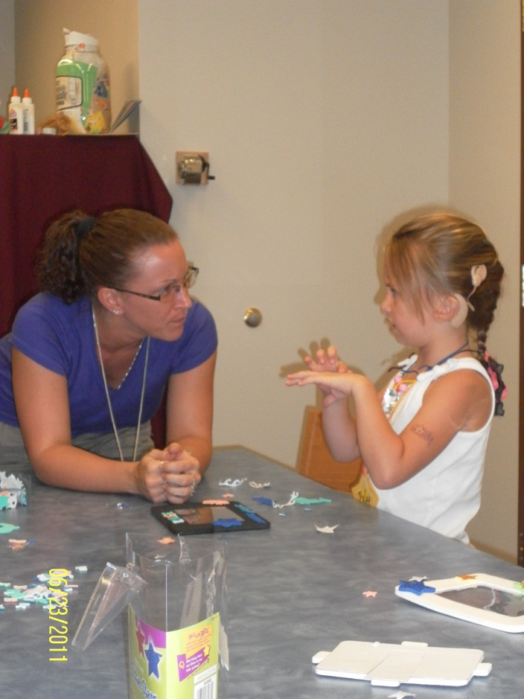
Individual Therapy 2011

Slide 21
Group Activities 2011

Slide 22
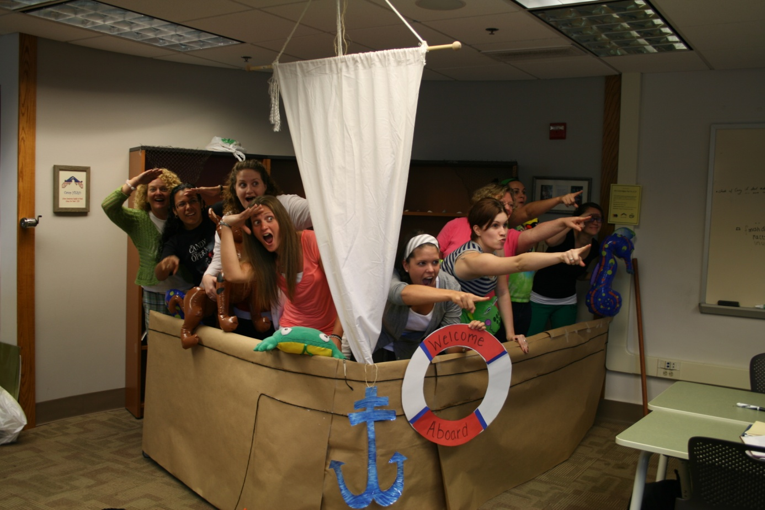
Summer Mini-Camp Practicum 2010: Adventure to Pirate Island

Slide 23
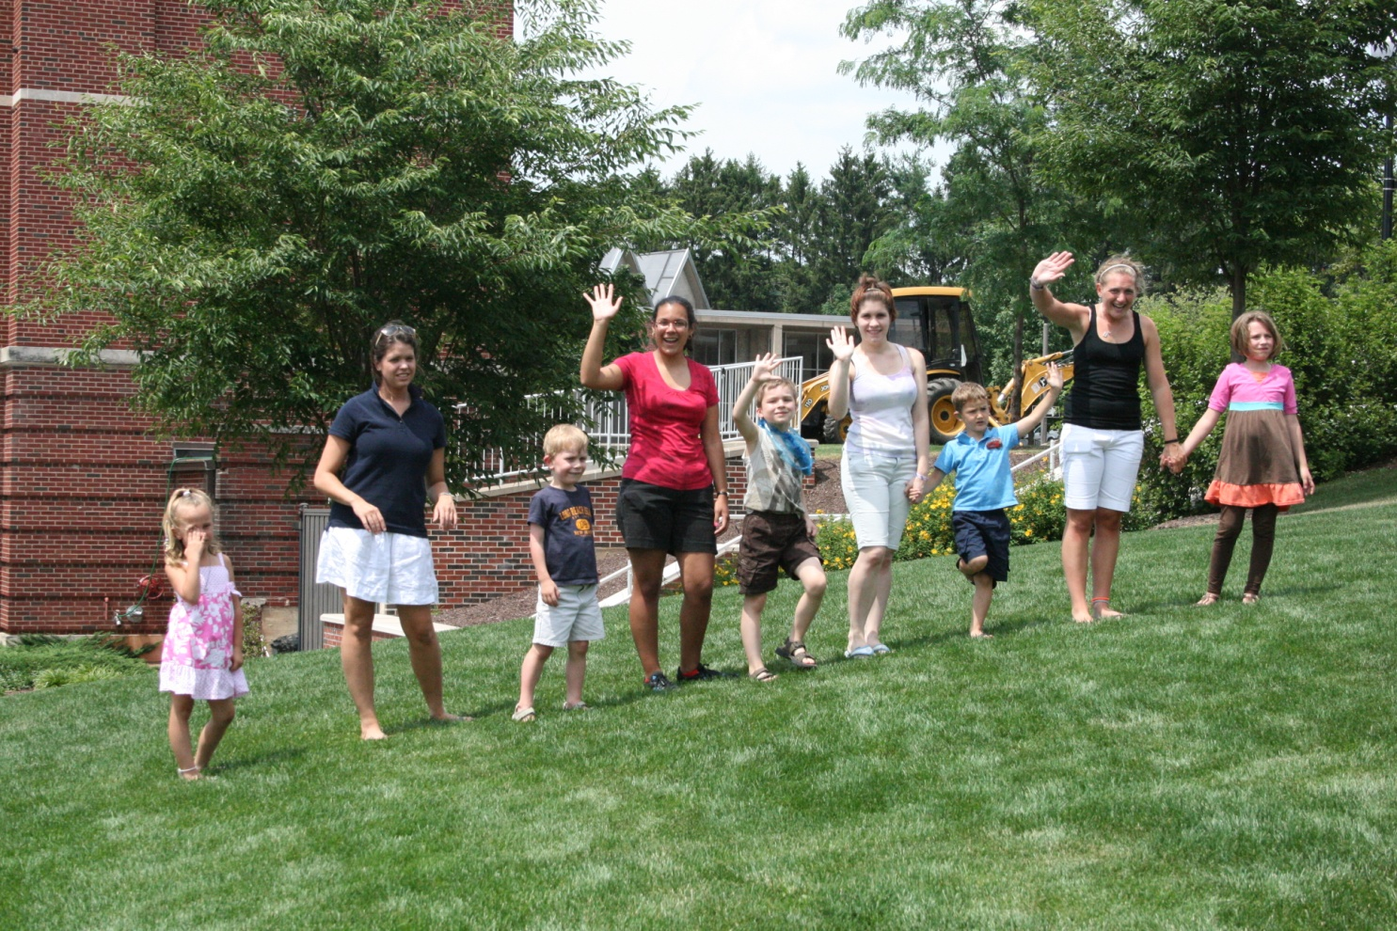
Summer Mini-Camp Practicum 2010

Slide 24
Summer Mini-Camp Practicum 2010

Slide 25
Summer Mini-Camp Practicum 2009

Slide 26
Summer Mini-Camp Practicum 2009

Slide 27
Summer Mini-Camp Practicum 2009

Slide 28
Summer Mini-Camp Practicum 2009

Slide 29
Summer Mini-Camp Practicum 2008

Slide 30
Playing “Duck, Duck, Goose”
Mini-Camp Speech Camp 2008

Slide 31
Creating a “fish mobile” using our new vocabulary words.

Slide 32
Reading a book and looking at the pictures.

Slide 33
Our paper bag puppets to go with our “Jungle Week”

Slide 34
Are you as tall as a monkey?

Slide 35
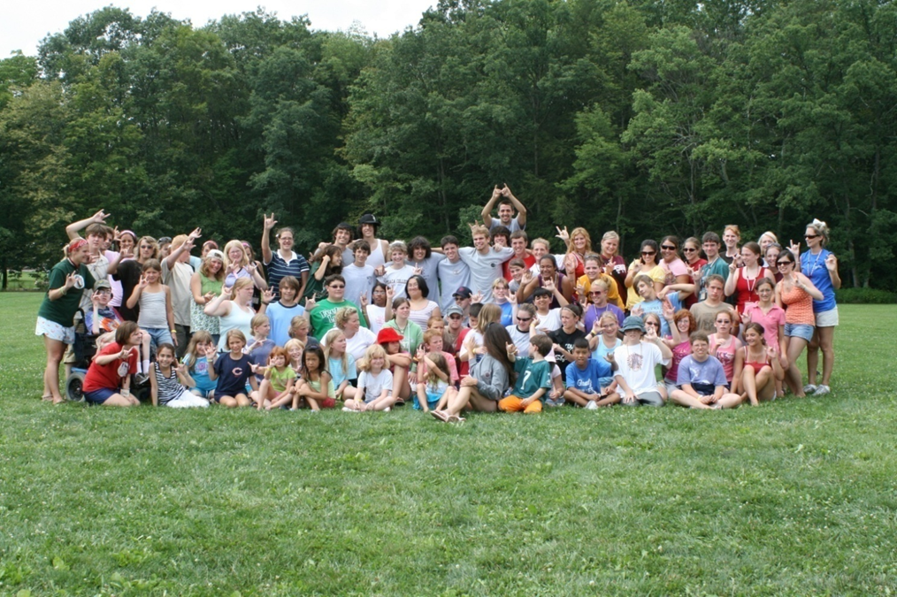
Nothing is better than Hands-on Experience!
Camp HERO

Slide 36
A high five after the relay race

Slide 37
Pose for the camera!

Slide 38
Sliding on the zip line!

Slide 39
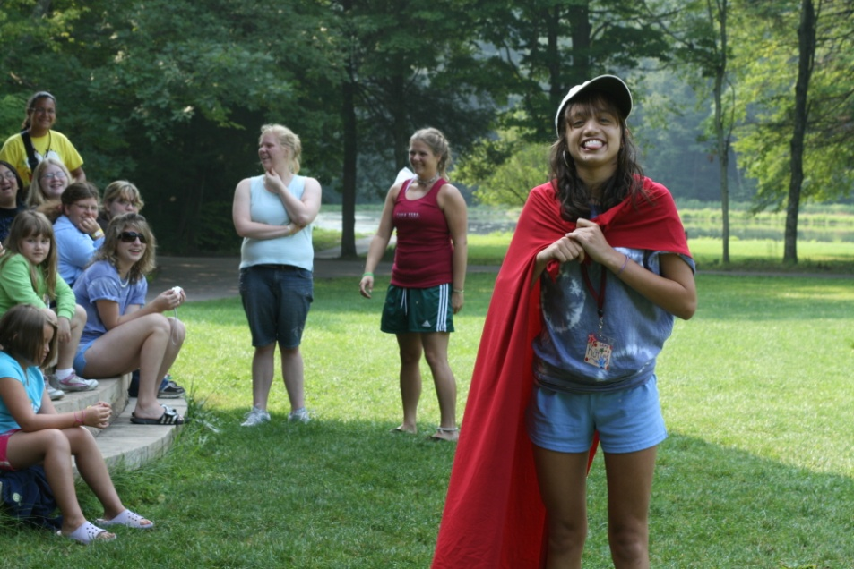
Making Fake Glass for “Stunt Camp”
Practicing a Scene for “Show Time”

Slide 40
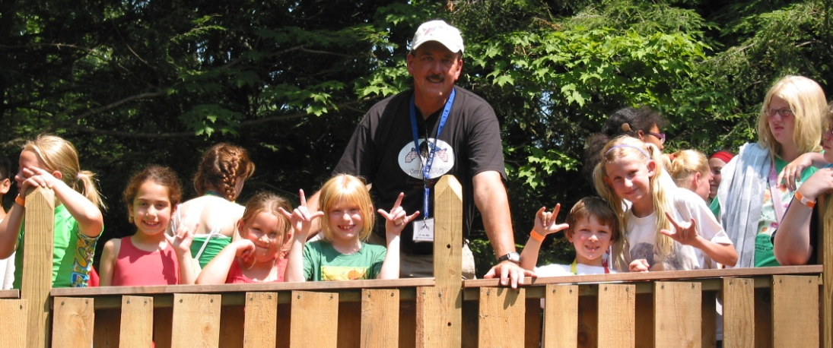
We have a Tree House!

Slide 41
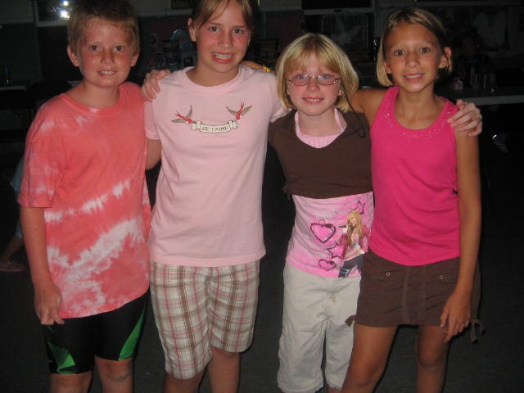
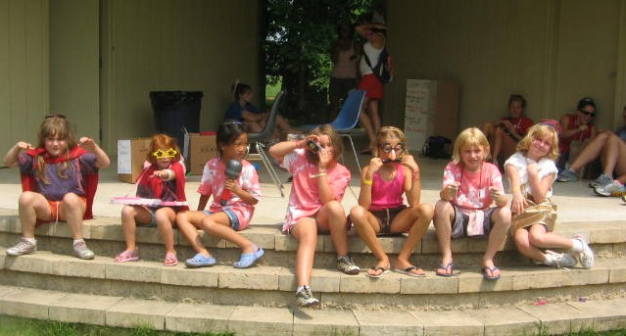
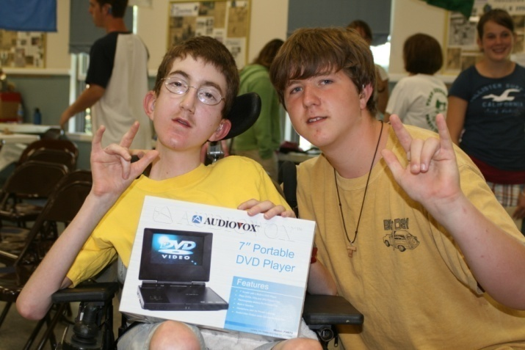

Slide 42
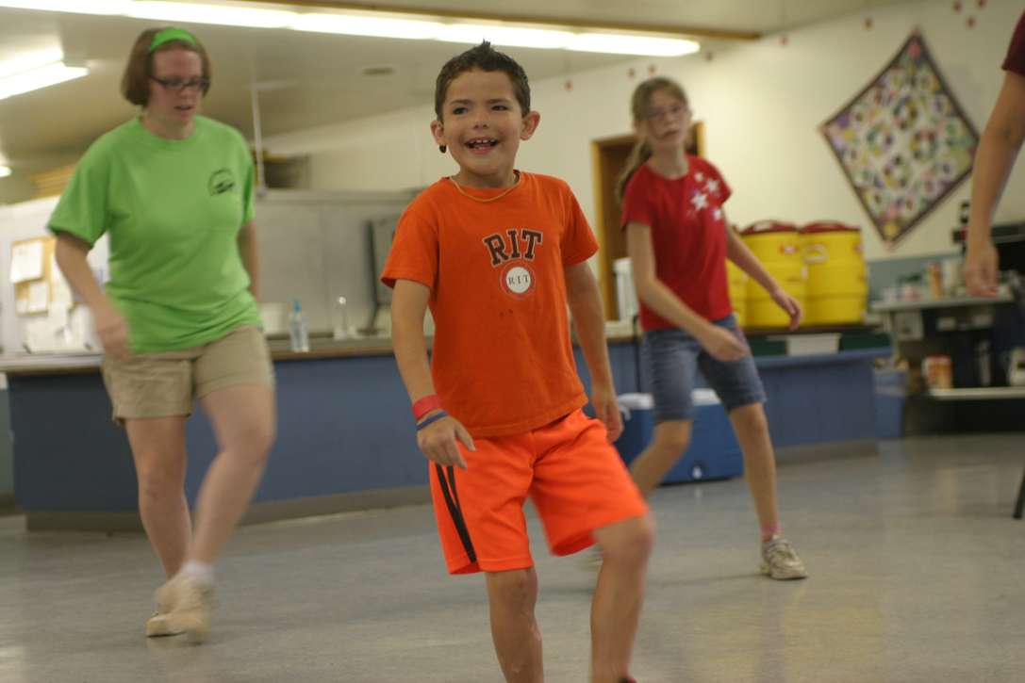
Working on our dance moves

Slide 43
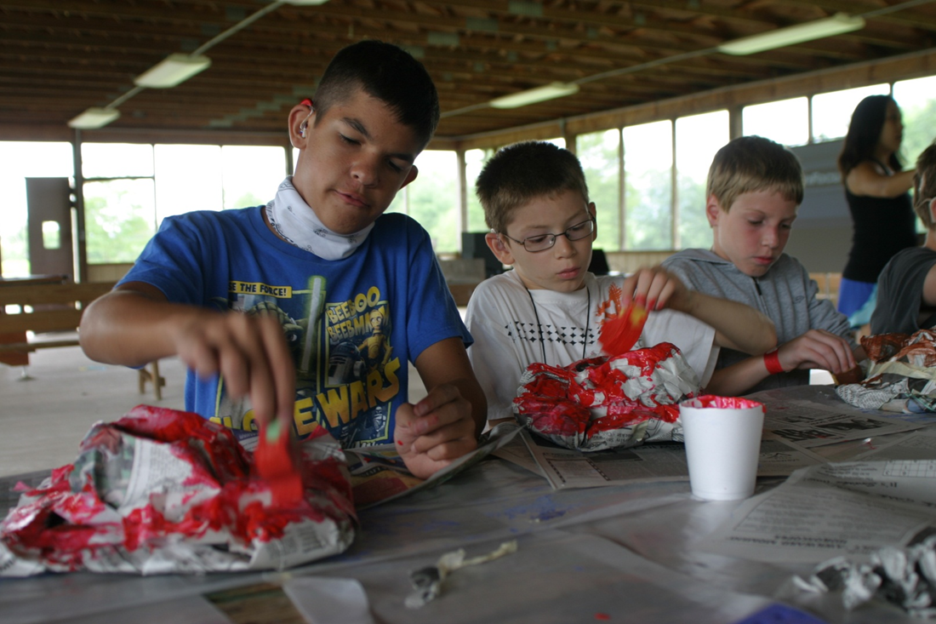
We made our very own cowboy hats!

Slide 44
Graduate Deaf Education Fall Semester
72.500 Auditory Training and Speechreading
70.575 Seminar in Current Issues in Special Education
74.462/562 ASL & Signed English in Educational Settings
74.569 Curricular Subjects for the Deaf/HH

Slide 45
Graduate Deaf Education Spring Semester
74.570 Student Teaching with the Deaf/HH (6 credits)
◆ 8 weeks in a classroom
◆ 8 weeks itinerant

Slide 46
Graduate Deaf Education Second Summer Semester ( 6 weeks)
74.575 Counseling Individuals with Special Needs and Their Families
74.584 Research in Education of the Deaf/Hard of Hearing

Slide 47
Graduates of the Education of the Deaf/HH Program at Bloomsburg University are eligible for:
Council on Education of the Deaf (CED) certification (national)
Pennsylvania Department of Education (PDE) certification
Licensure from the Pennsylvania State Board of Examiners in Speech, Language and Hearing

Slide 48
Department of Exceptionality Programs
Education of the Deaf
and
Hard of Hearing
Faculty

Slide 49
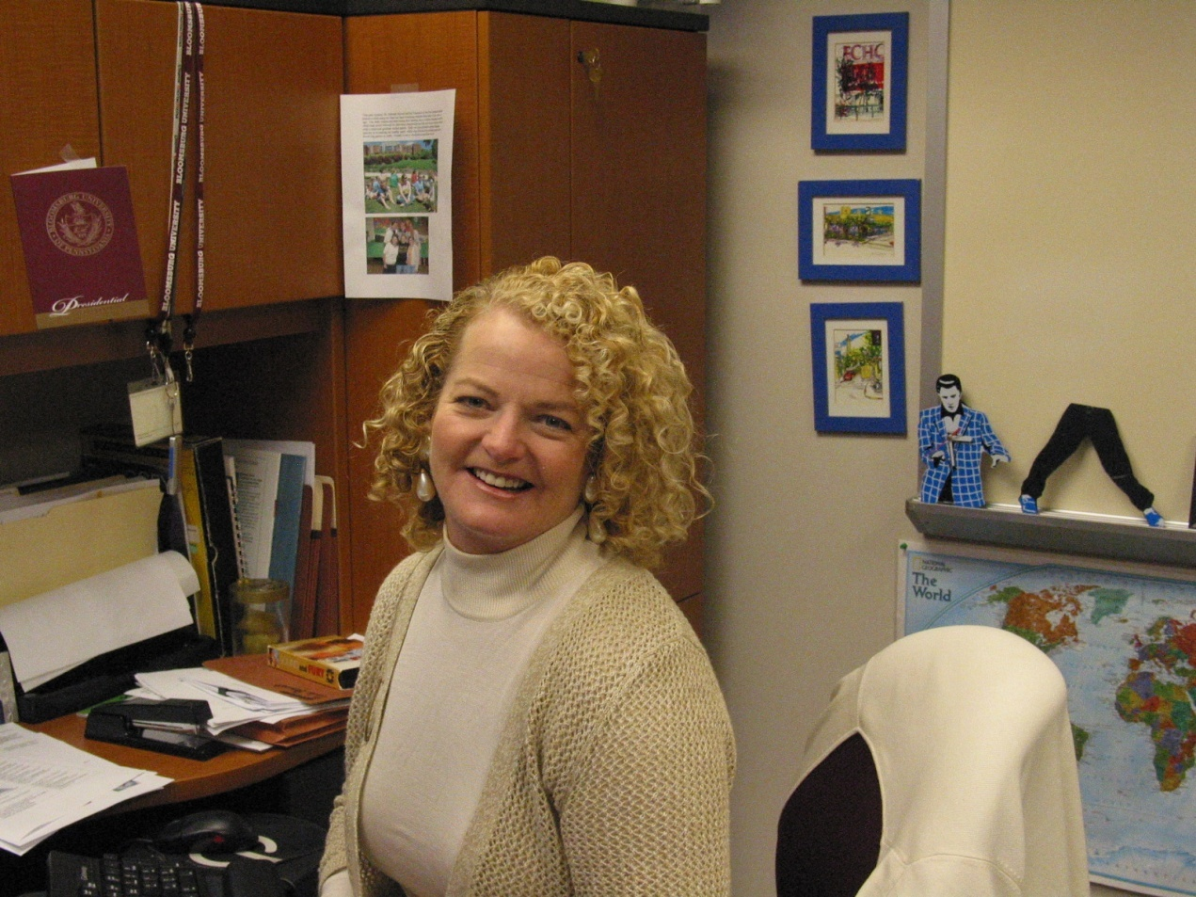
Dr. Deborah Stryker, Program Coordinator

Slide 50
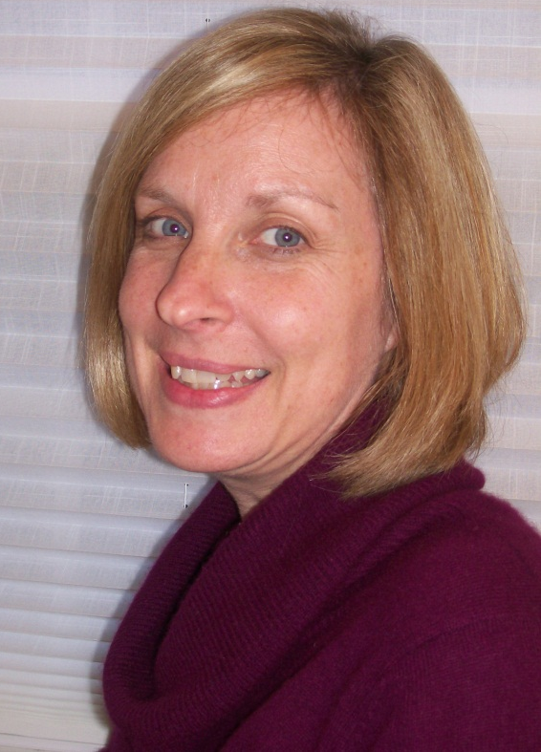
Mrs. Mary Ann Helfrich, Adjunct for our Speech class and Mini-Camp!

Slide 51
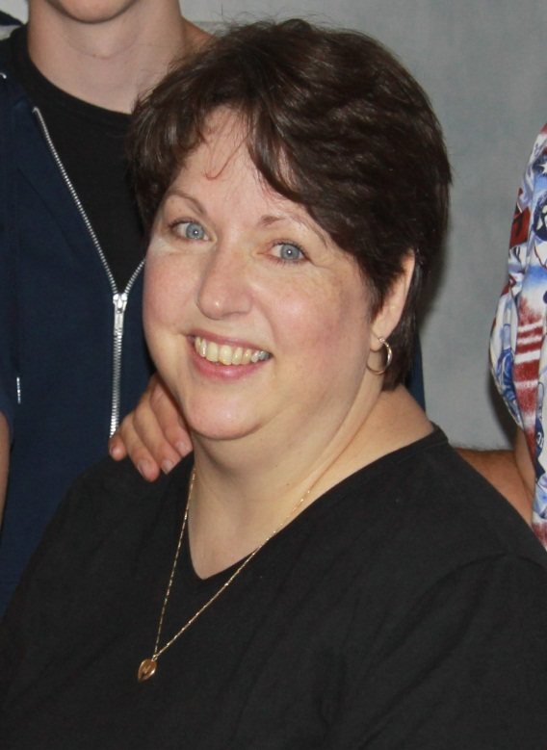
Dr. Patricia Stoudt, Adjunct and teaches online and on campus courses!

Slide 52
Education of the Deaf
Visit our website at:
www.bloomu.edu/deaf_education

